Slide 1

Adventure Works end to end
Presented by Ahmed Zaki
1

Slide 2
Project Agenda
1
2
3
4
5
Intro & overview
Explain the problem
Project Goals
Creation Process
Results & Achievements
5
6
Phase 1 (Photos and every thing about this phase)
Phase 2 (Dashboards )
2

Slide 3
Project Introduction
This project delivers an end-to-end data solution combining a scalable data warehouse with interactive business intelligence dashboards. On the engineering side, a columnstore-based star schema was implemented and populated through dynamic SSIS pipelines, handling both initial and incremental loads with a staging layer to ensure data quality and efficiency. Slowly changing dimensions were applied to track historical changes in customer and product data, enabling accurate time-based reporting. On the analytics side, Power BI dashboards were developed to present KPIs, revenue and profit trends, customer behavior, and product performance, with interactive maps and filters that support clear, structured, and data-driven decision-making.
3

Slide 4


Challenges Before the Solution
01
02
No centralized data warehouse
OLTP systems under pressure
reports were scattered, queries were slow, and historical tracking (SCD) was missing, limiting reliable analytics.
analytical queries ran directly on transactional databases, affecting performance and daily operations
03
04
Limited business visibility
Static Report
managers lacked clear dashboards to monitor KPIs like revenue, profit, orders, and customer activity.
no interactivity, filters, or drill-down options to support flexible, data-driven decision-making.
4

Slide 5

Project Golas
Step by step methodology for building comprehensive and actionable project
3
2
4
1
⚡
5
🏛️
📊
🔄
Performance Optimization
Data Warehouse Design
Business Intelligence Dashboards
Minimize the impact on OLTP systems by isolating analytical workloads, extracting only required data, and optimizing queries for efficiency.
Data Integration
Implement a star schema with columnstore indexes and apply Slowly Changing Dimensions (SCD) to ensure accurate historical tracking and fast analytics.
Develop Power BI dashboards with KPIs for providing a quick business snapshot for decision-makers
Service Analytics
Build a dynamic SSIS data integration pipeline supporting both initial and incremental loads, with a staging layer for controlled and repeatable data movement.
Enable flexible decision making with maps, filters, and drill-downs, empowering stakeholders with interactive, data-driven insights.
5

Slide 6
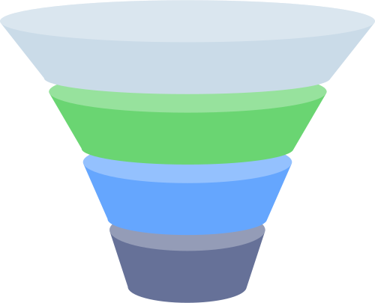

From Data to Insights
📊
Dashboard Development
connected the warehouse to Power BI and created interactive dashboards showing KPIs, trends, and profitability.
🏛️
implemented a star schema with fact and dimension tables, optimized with columnstore indexes and SCD logic.
Data Warehouse Design
ETL Pipeline Development
🔄
built SSIS pipelines for both initial and incremental loads, applying transformations and data quality checks.
Data Extraction & Staging
🗄️
pulled data from OLTP systems into a staging layer to prepare for controlled, repeatable loading
6

Slide 7






Results & Achievements
Optimized Data Integration
Improved Query Performance
High Performance Data Warehouse
🏛️
interactive Dashboards
Built dynamic SSIS pipelines for both initial and incremental loads, ensuring reliable and repeatable data movement.
Implemented Slowly Changing Dimensions (SCD) to track historical changes and improve time-based insights by 95%+ , Queries ran up to 70% faster compared to OLTP.
Designed a star schema with columnstore indexes, reducing query time and boosting analytical performance.
Designed interactive Power BI dashboards showing customer behavior, sales trends, product performance, and profitability to increase increased decision-making speed by 60%.
7

Slide 8
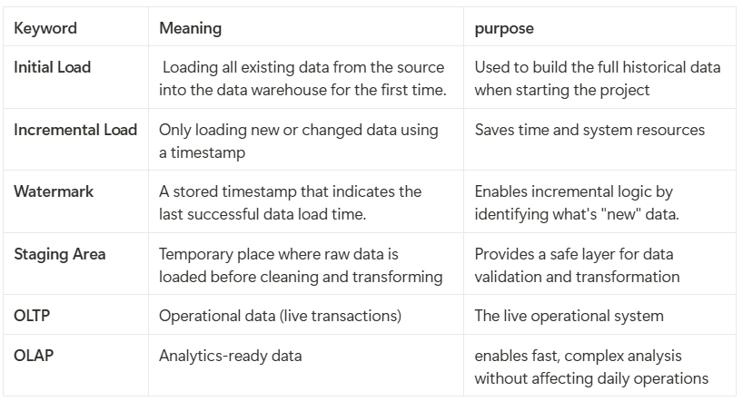
Some Keywords
01.
ETL Pipeline Development in SSIS
02.
Extract: Extracting data from OLTP to Staging (full for dimensions, Updated for facts using watermarking).
Transform: Clean, enrich, and apply business logic (e.g., product language filtering, surrogate key mapping).
Load: Populate DW dimensions and facts, ensuring consistency, and handling overrides/history where needed.
8

Slide 9
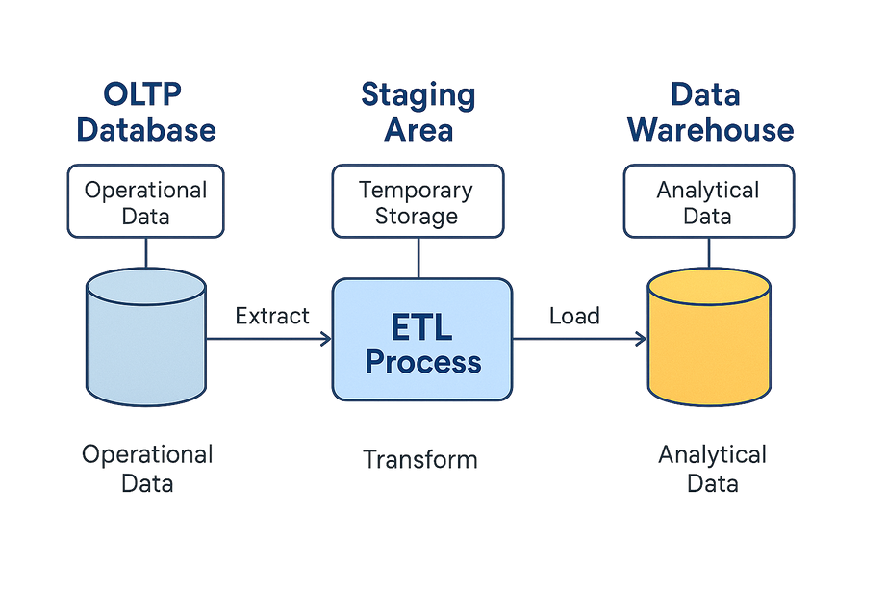
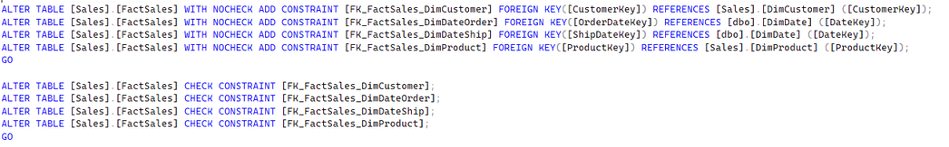
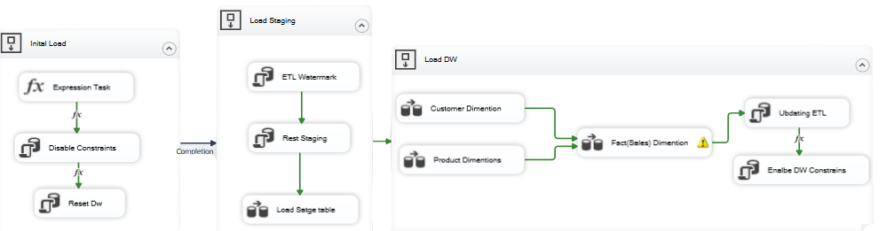
Architecture&Pipeline
Architecture
Pipeline
Updating Wtermark
9

Slide 10
Phase1
ETL pipeline development and Data Warehouse architecture
10

Slide 11

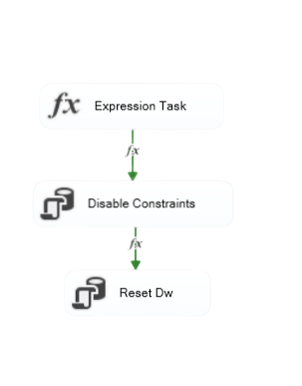
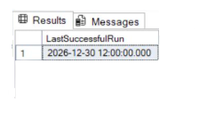

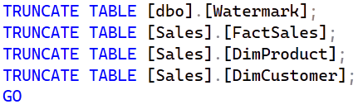
initialization
V1
Mechanism of loading (Initial , incremental)
V2
11

Slide 12
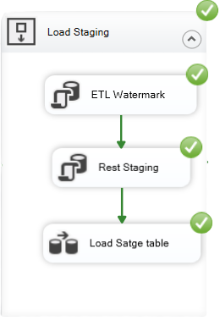

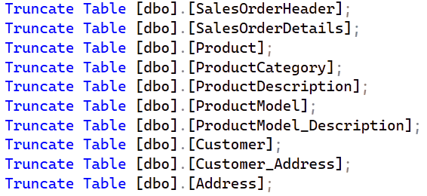
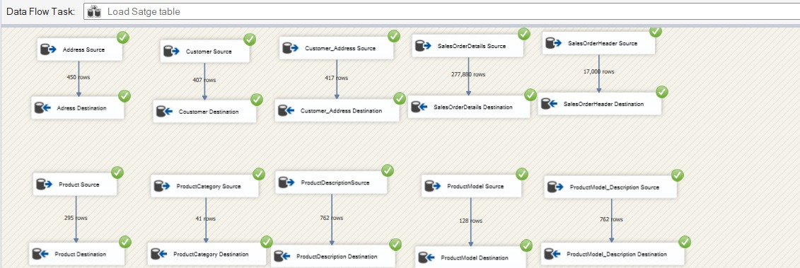
Load Staging in details
Data Source (OLTP)
Data Destnation
12

Slide 13
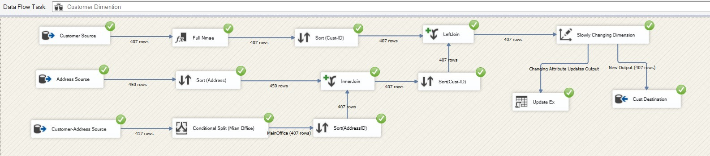
Customer Dimension in details
Presentation 2024
Merging FirstName,Lastname into fullanme
Handling data changes
-
Thynk Unlimited
Selecting only type office “Main Office”
13

Slide 14
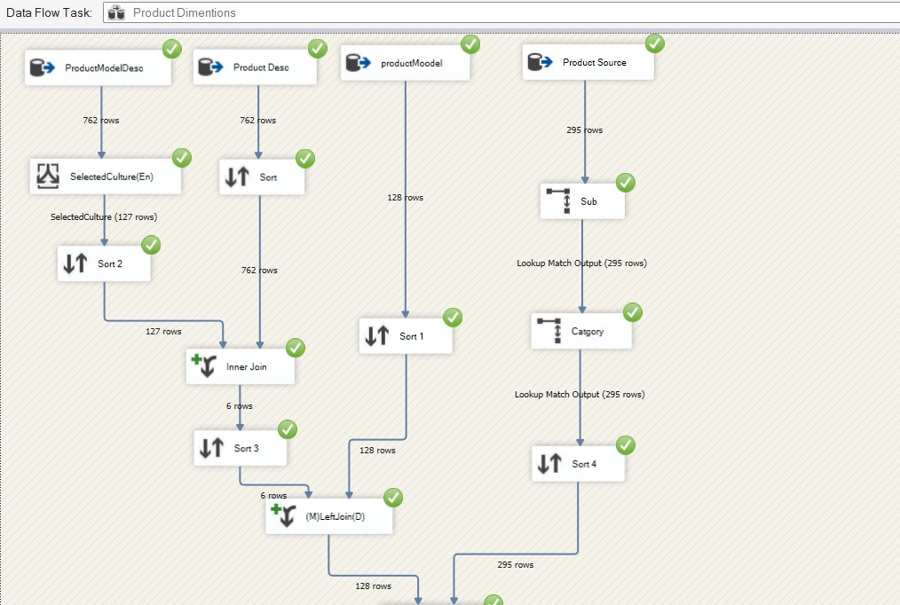
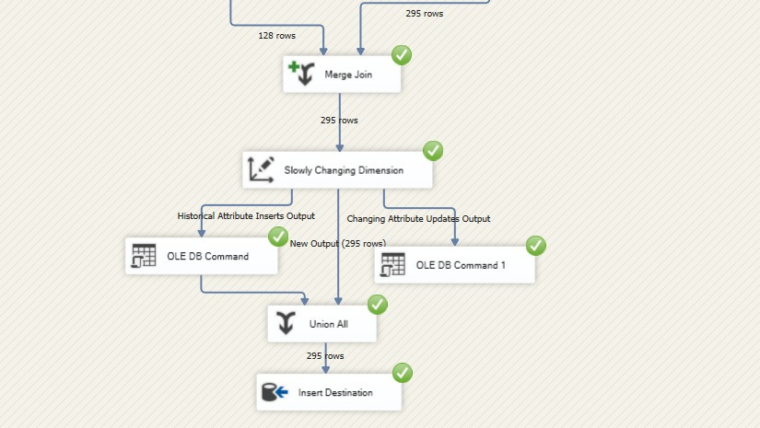
Product dimension in details
Match input data rows with existing records from another source
Conditional Split to Control data and take only selected things
Define data changes (Historical , changes )
14

Slide 15
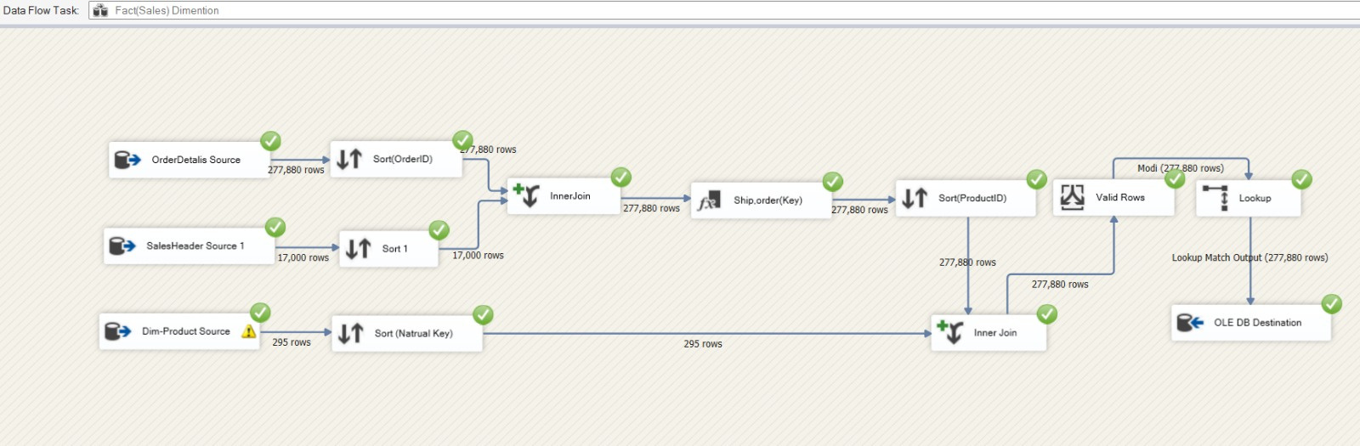
Fact in details
filters rows where the ModifiedDate falls within the valid range of EffectiveStartDate and EffectiveEndDate
Prepares order data by generating OrderDateKey and ShipDateKey columns and make the date is clear without “-”
15

Slide 16
Comparing data in both Incremental(V1) and Initial (v2)
16

Slide 17
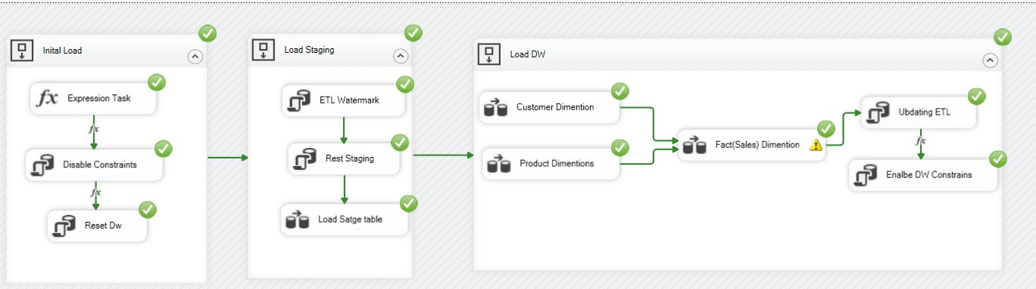
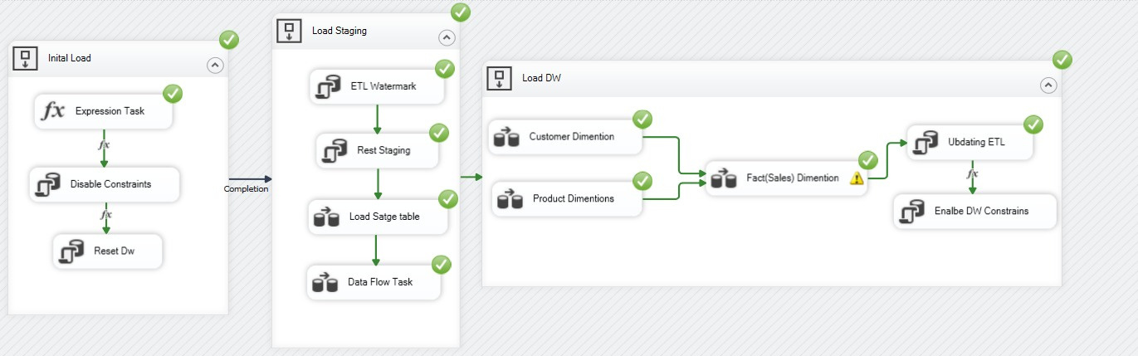
Pipeline
V1
V2
17

Slide 18
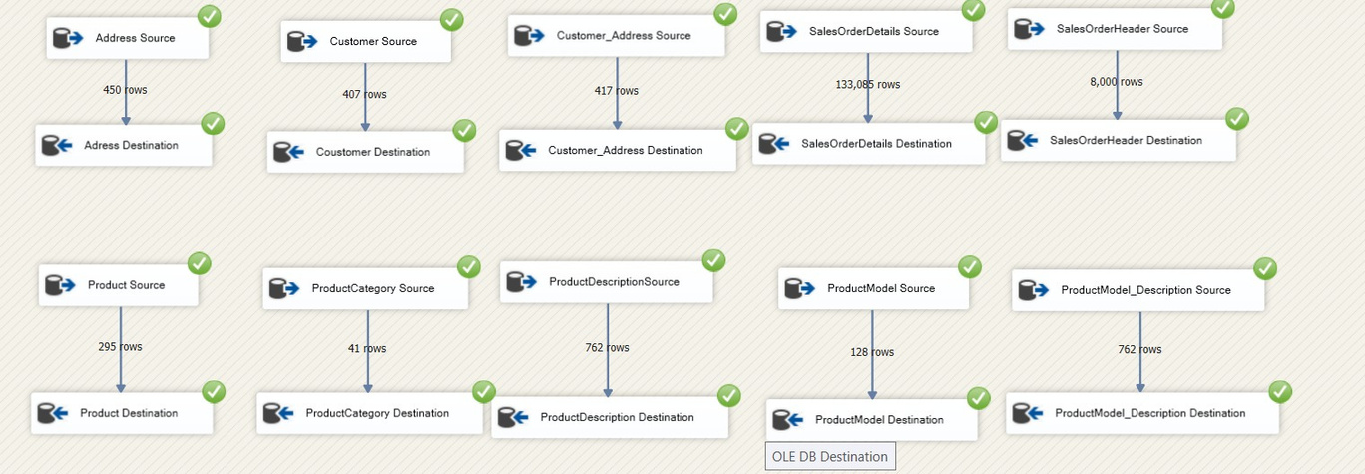
Load Staging
V1
V2
18

Slide 19

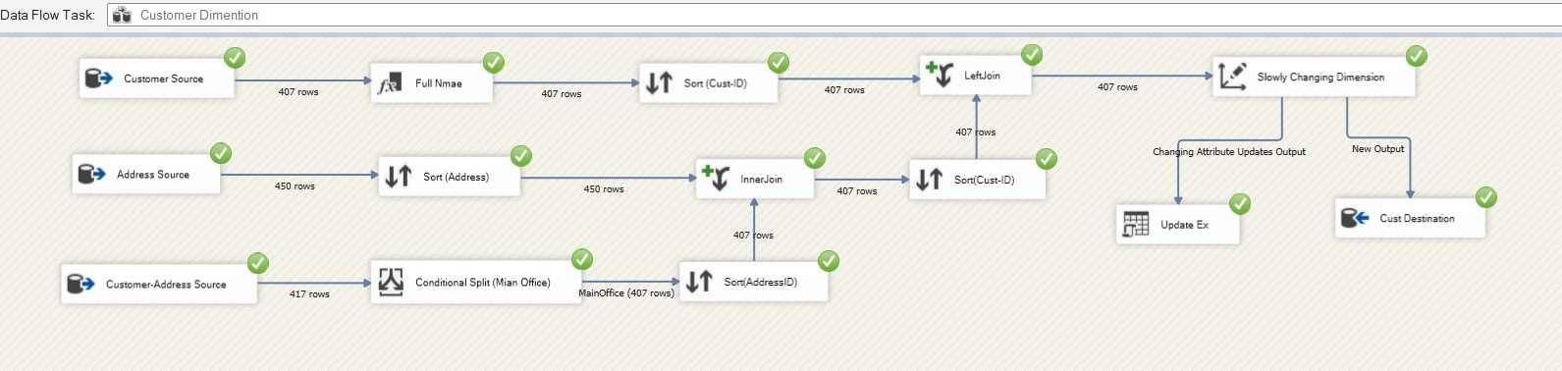
Customer dimension
V1
V2
19

Slide 20
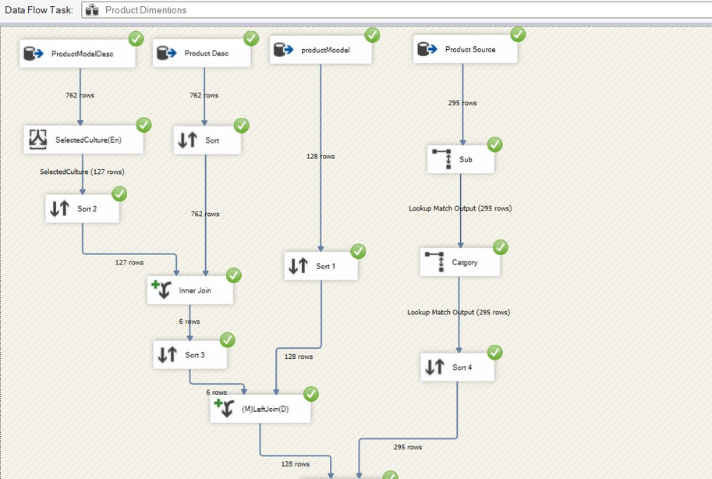
Product dimension
V1
20

Slide 21
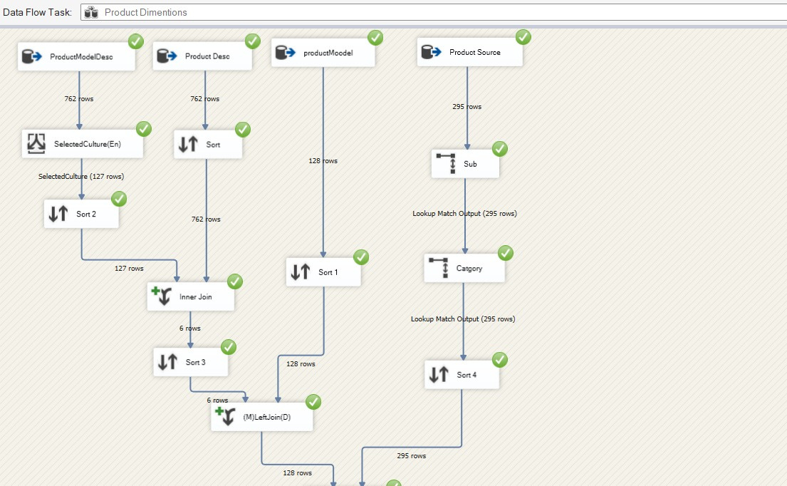
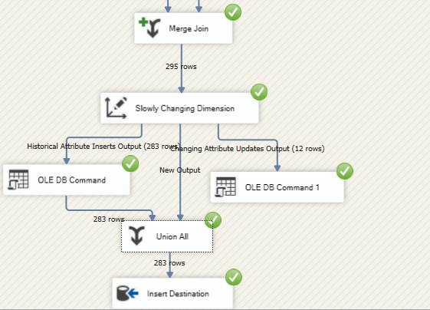
Product dimension
V2
21

Slide 22
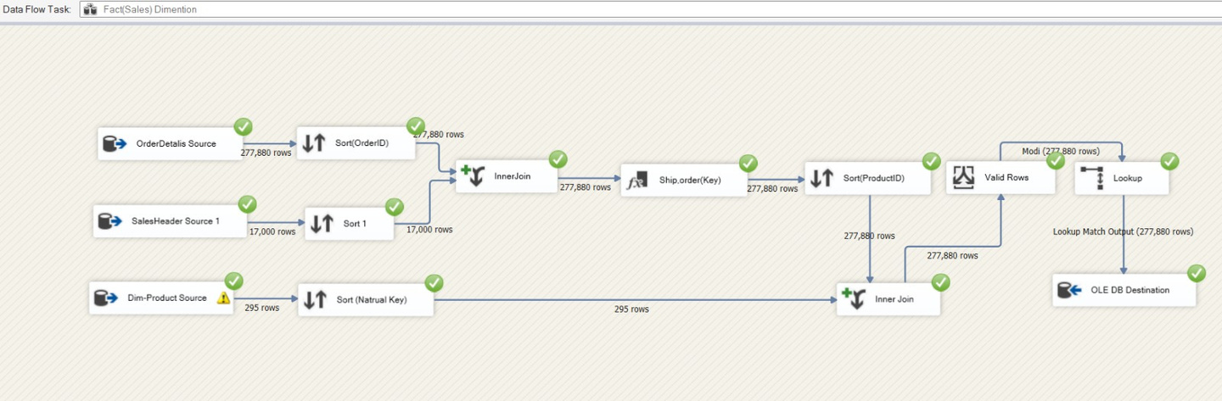
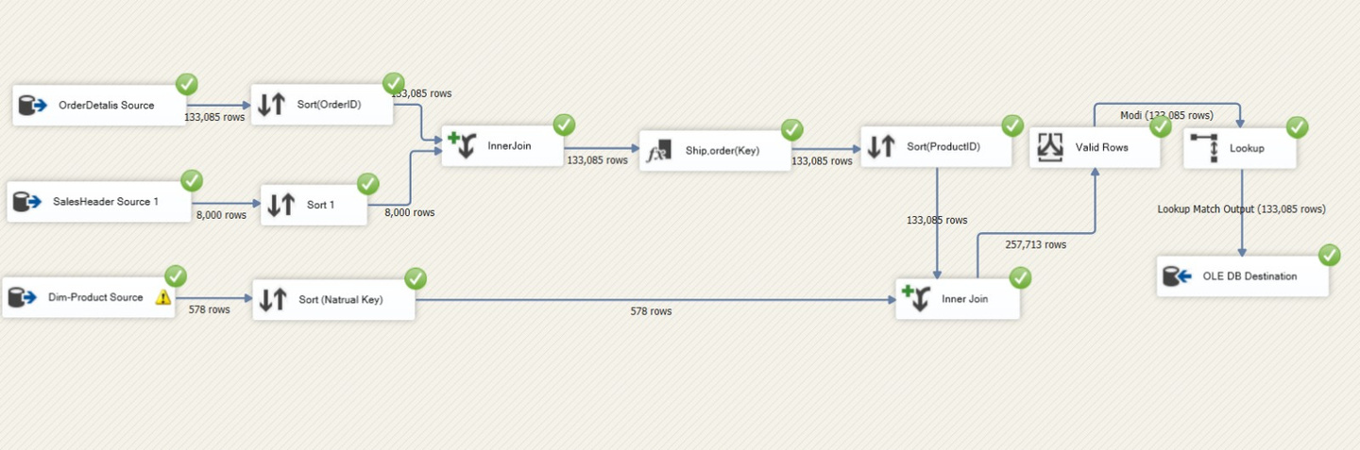
Fact
V1
V2
22

Slide 23

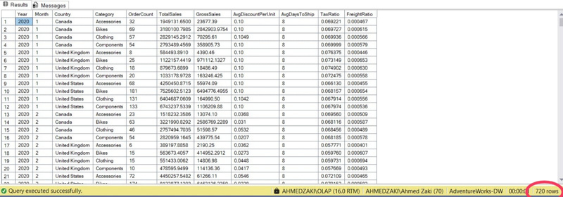
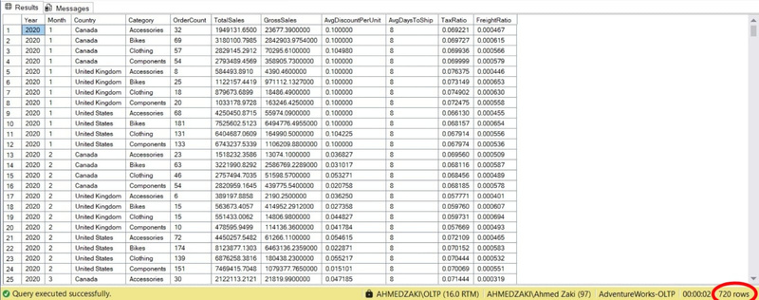
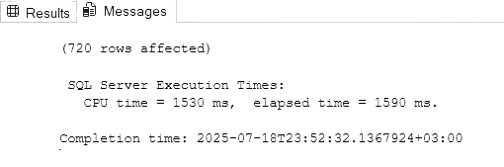
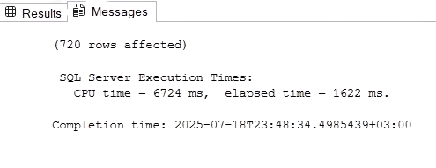
OLAP vs OLTP : Performance & Purpose
OALP
OLTP
Analytical Queries
Transactional Queries
Optimized for reporting, aggregations, and complex joins using a star schema.
Designed for frequent inserts, updates, and deletes in operational systems.
vs
Historical Tracking
Real-Time Operations
Handles Slowly Changing Dimensions (SCD) for accurate time-based analysis.
Supports day-to-day business like orders, customers, and inventory.
23

Slide 24
Phase2
Interactive Dashboards and Business Insights
24

Slide 25
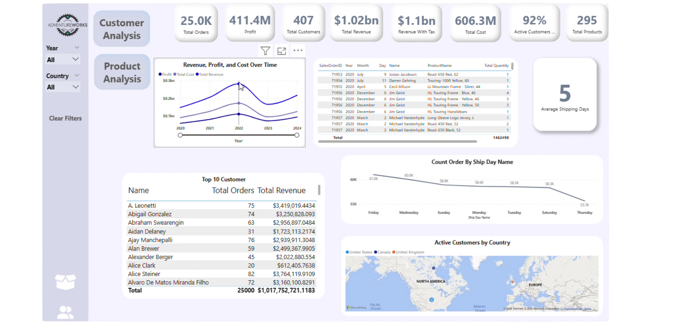




Customer Analysis
Tracked Kpis
to provide a quick business snapshot
Revenue & Profit Trends
to track financial performance and detect growth or decline
Customer Insights
to identify the best sellers
Market Reach
Mapped active customers by country to monitor geographical distribution and expansion opportunities.
25

Slide 26
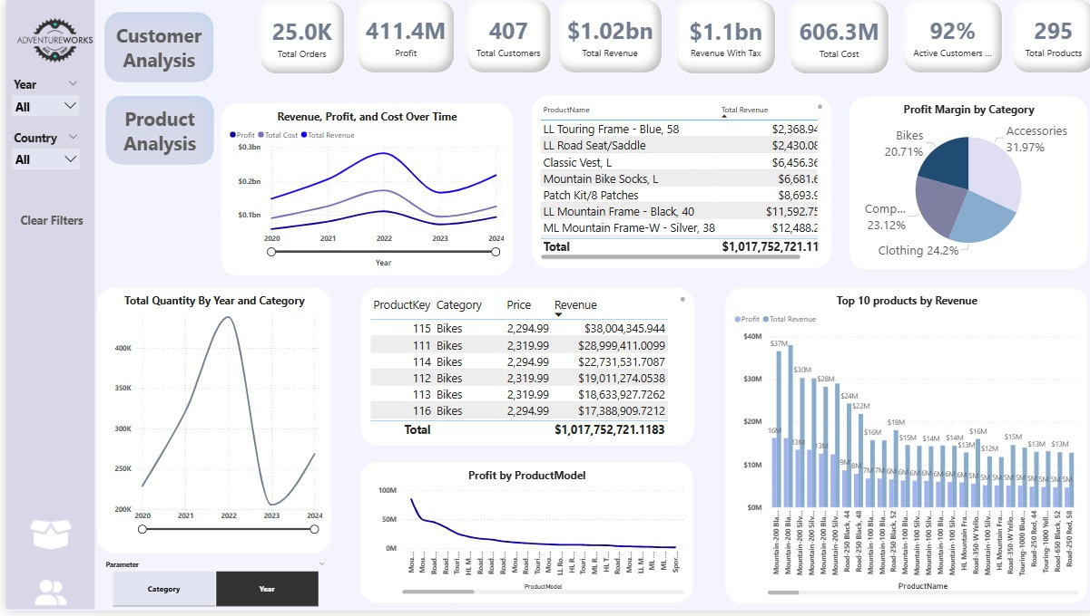
Product Analysis
Shows total KPIs
for providing a quick business snapshot for decision-makers
Revenue & Profit Trends
to track financial performance and detect growth or decline
Customer Insights
to identify the best sellers
Interactive filters
enable customized analysis for specific markets or periods
26

Slide 27
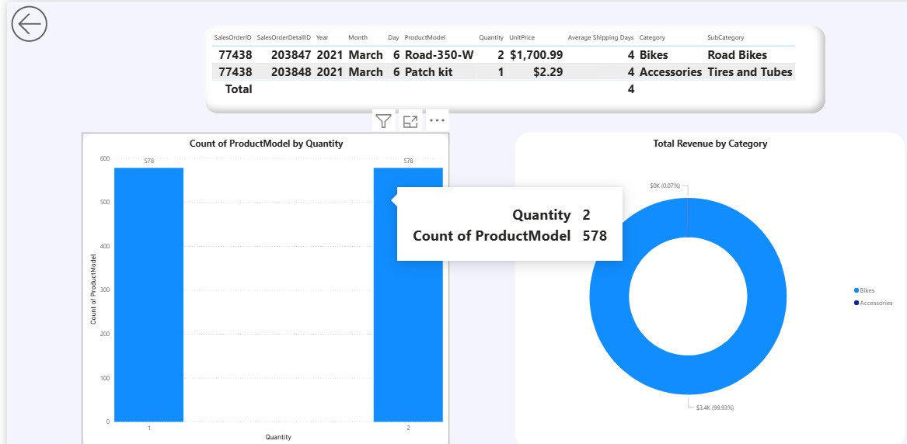
Order
Page
Count of product models by quantity
to understand product diversity and sales spread.
Revenue by category
to compare categories and guide investment in profitable segments.
27

Slide 28
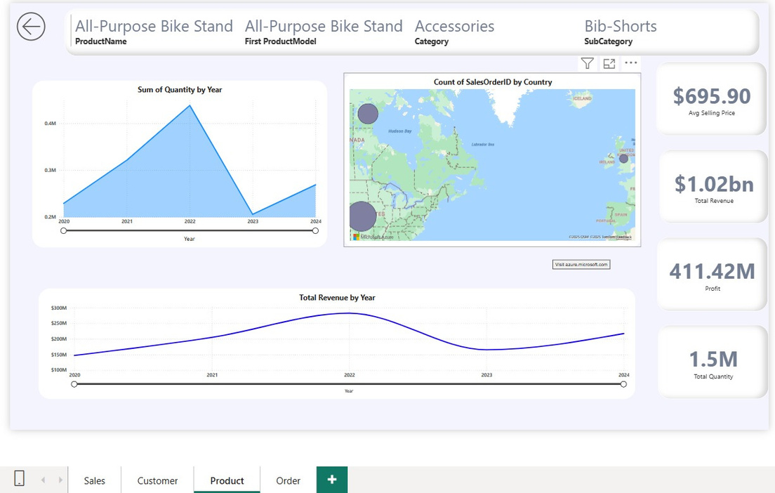
Product Page
Quantity sold by year
to analyze demand trends over time.
Sales distribution by country
to understand geographic demand and support regional strategy
28

Slide 29



Thank You
AhmedZakiGbr
iahmedzaki10@gmail.com
29

